Slide 1
Sugar pine
Demographic status, trajectory, and stressors

Slide 2
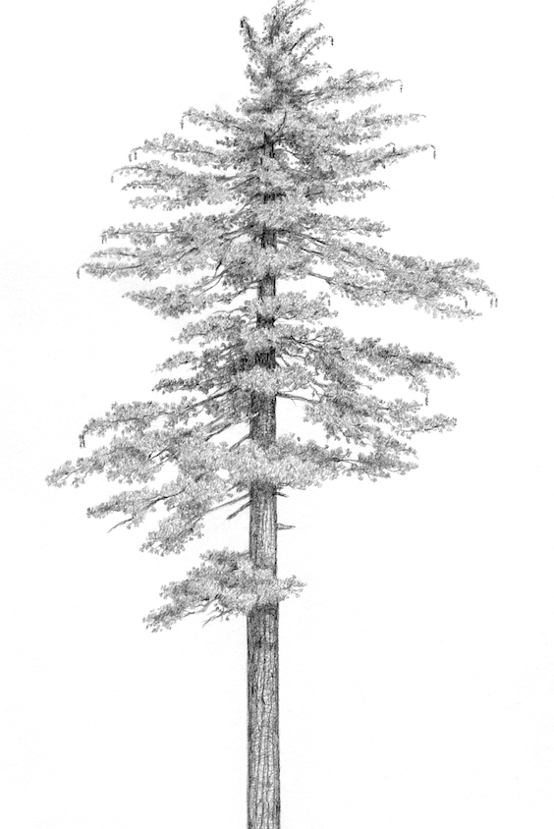
Pinus lambertiana (sugar pine)
5-25% of basal area in the mixed conifer forest type in CA and OR
Valuable food source for wildlife
The largest member of Pinus, the “Queen of the Sierra”
Facing numerous threats
Matt Strieby

Slide 3
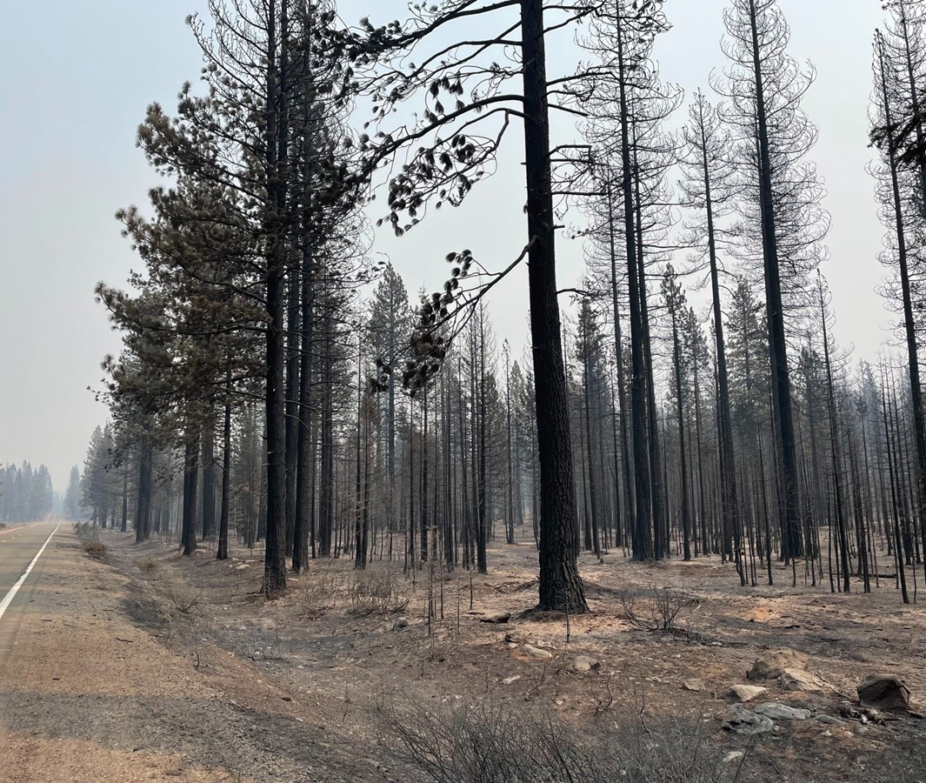
High-severity fire
Increasing area affected
Increasing HS patch size
Scott Rodd, capRadio

Slide 4
White pine blister rust
Dudney et al., (2020) Ecosphere
Geils et al., (2010) Forest Pathology

Slide 5
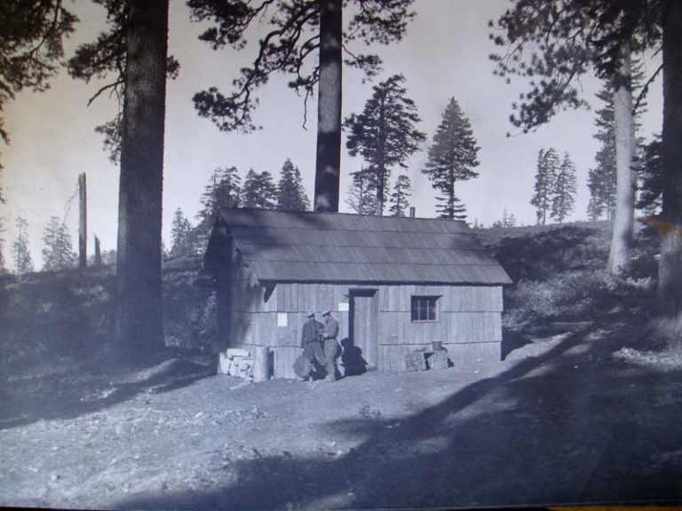
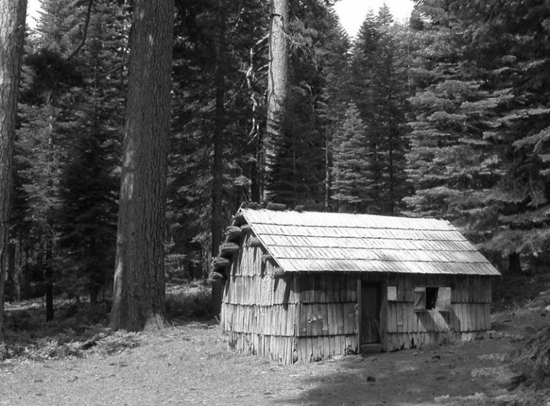
Densification
Plumas National Forest
Plumas National Forest

Slide 6
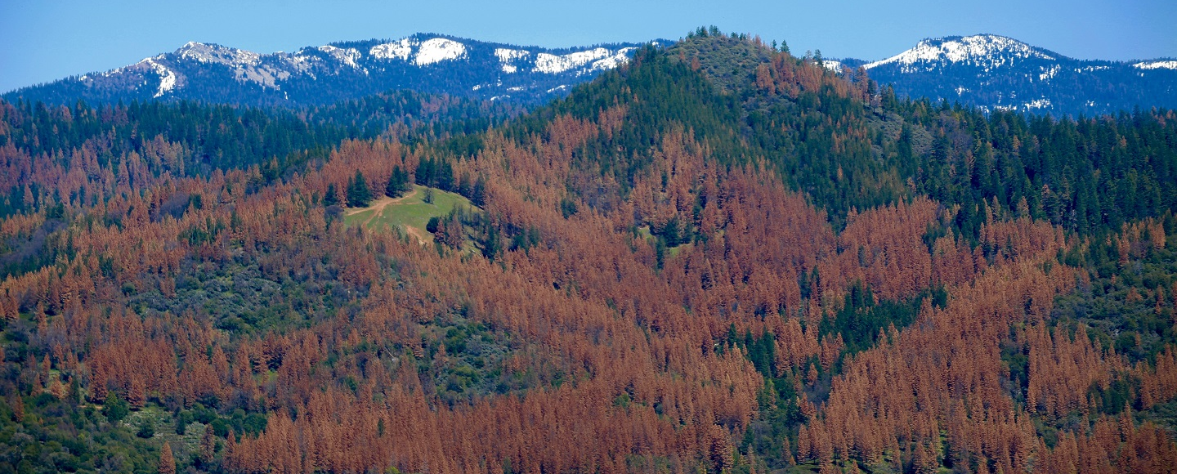
Drought and bark beetles
NASA

Slide 7
Questions
What is the relative importance of the various stressors affecting sugar pine?
What is the current status and trajectory of the ensemble of sugar pine populations across its range?

Slide 8
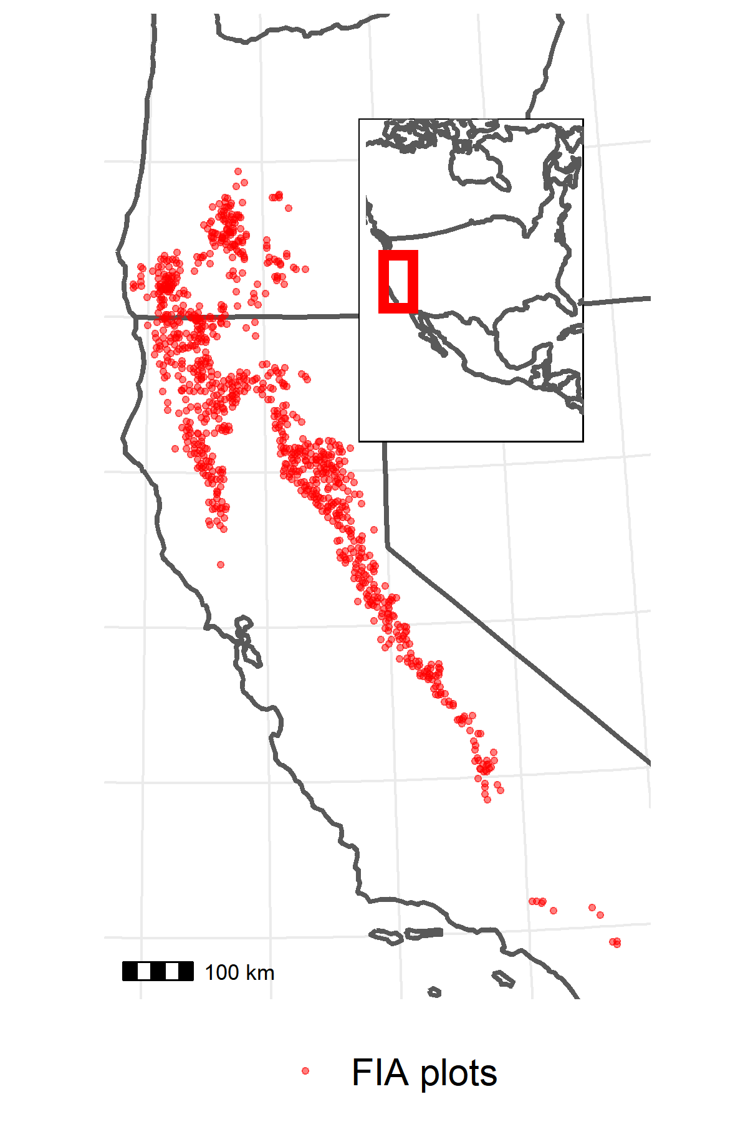
Data
US Forest Service Forest Inventory and Analysis (FIA) plot network
956 plots within mapped PILA range and with PILA present
1/10th of plots visited every year since 2001
~10 years between visits, 2 visits per plot
On each plot:
Inventory of trees: Species, live/dead, diameter at breast height (DBH), evidence of damage/disease (e.g., WPBR)
Tally of seedlings by species
Presence of disturbances (e.g., fire)
TerraClimate dataset to estimate mean growing season climatic water deficit (CWD) at each plot location in each year

Slide 9
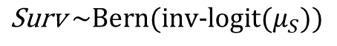
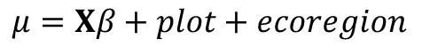
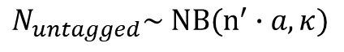
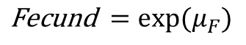
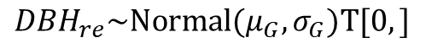
Analysis
Explanatory variables
Vital rate functions
Survival
Integral projection model
Fire
WPBR
Basal area
Drought
Site dryness
Growth
Fecundity
Size-class transition matrix
Asymptotic population growth rate
Interactions with DBH
DBH
$$\text{S}\text{urv} \sim \text{Bern}\text{(}\text{inv}\text{-}\text{logit}(μ_{S}))$$
$${DBH}_{re}\sim \text{Normal}\text{(}μ_{G}, σ_{G})T[0,]$$
$$\text{F}\text{ecund} =exp⁡(μ_{F})$$
$$μ=Xβ+plot+ecoregion$$
$$N_{untagged}\sim \text{N}B(n^{′}∙a, κ)$$
Based on Shriver et al. (2021)

Slide 10
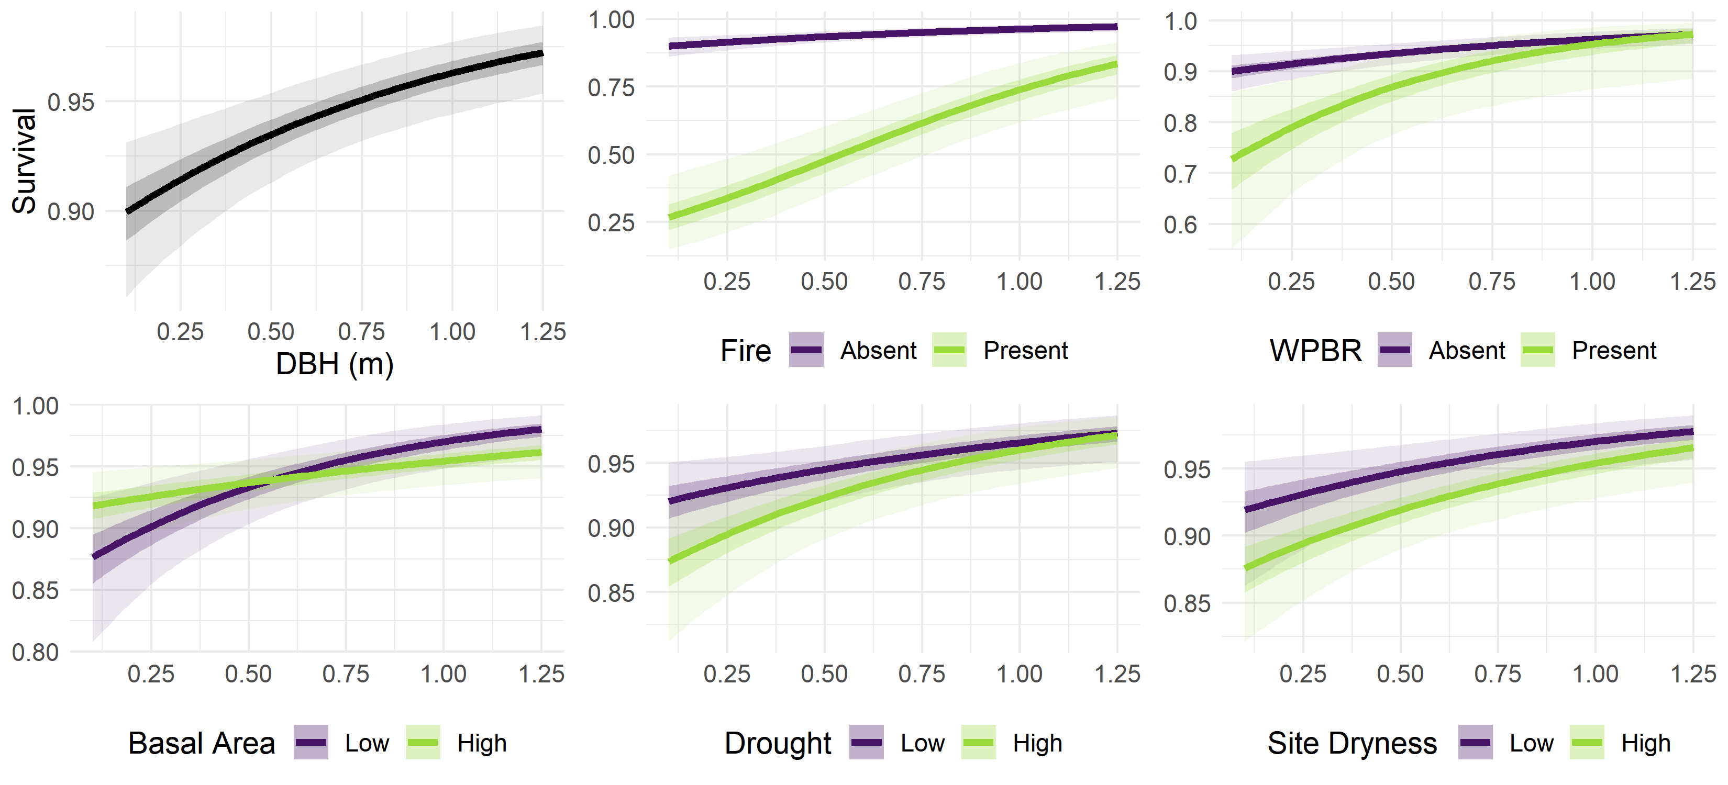
Results: Survival

Slide 11
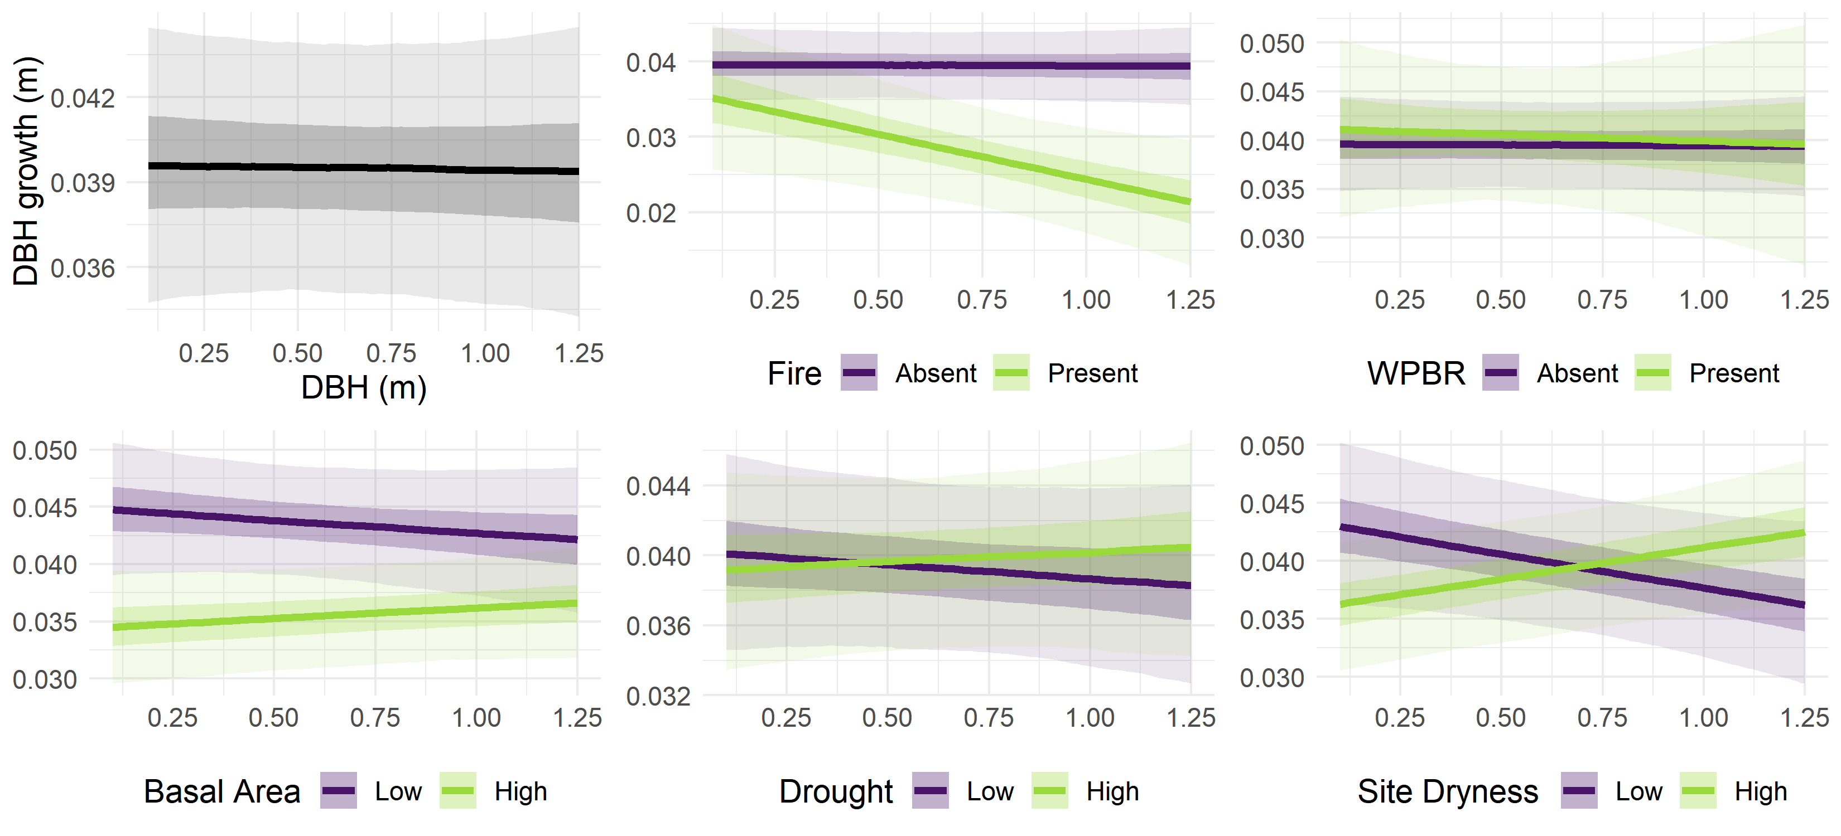
Results: Growth

Slide 12
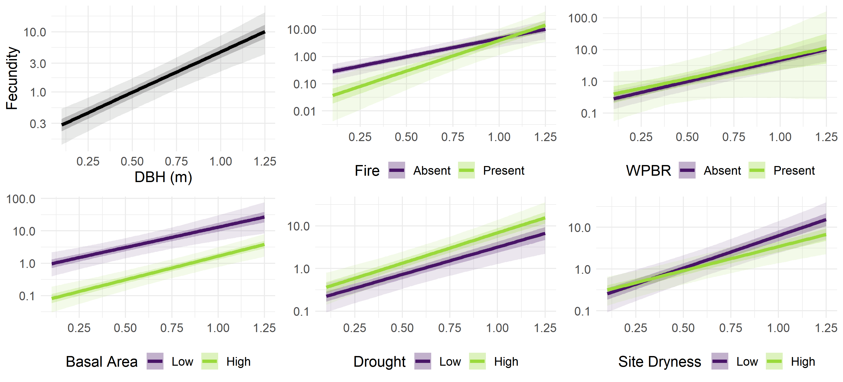
Results: Fecundity

Slide 13
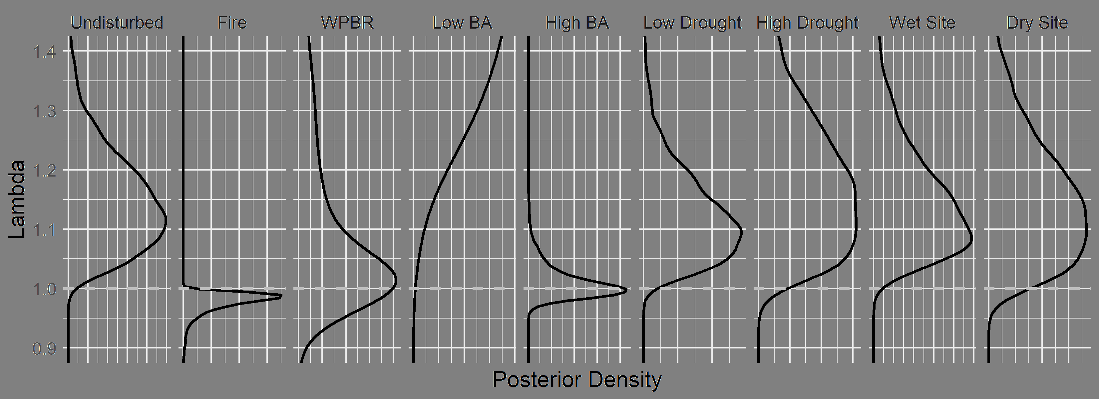
Results: Stressor effects on asymptotic population growth rate

Slide 14
Results: Stressor effects on asymptotic population growth rate

Slide 15
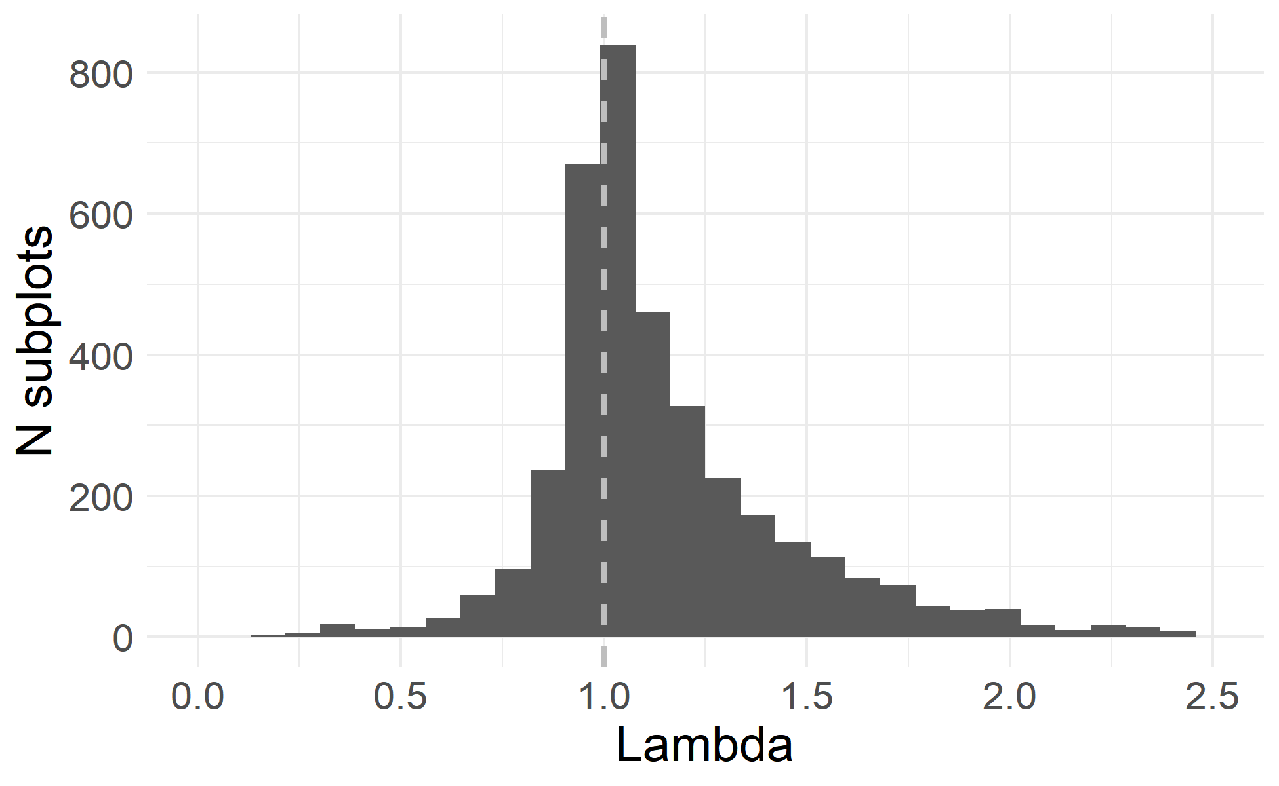
Results: Asymptotic population growth rate across sampled subplots

Slide 16
Management implications
Insights:
Fire and density are key stressors
Demographic value of large/old individuals
Responses:
Fuel treatments
Density reduction
If using Rx fire, protect valuable trees
Postfire restoration using WPBR-resistant seedlings

Slide 17
Feedback items
How to pitch / frame a paper for FEM / CJFR
“How should we conserve sugar pine?” (why care?)
“How are stressors affecting the mixed conifer forest type?” (too complex?)
“Here’s a way to prioritize management for species of concern” (methods paper w/o new methods)
Presentation feedback
North American Forest Ecology Workshop (~15 mins)

